Slide 1

MAD 3125 Android Development Fundamentals
Final Project Presentation
Project Name : TOUR BUDDY
Team No : 5

Slide 2
Team Information
Product Owner:
Jigisha Patel
Team Members:
João Rebelo (706998)
Shashank Machani (738286)
Santosh Tekulapally (738169)

Slide 3
Overview
One of the fastest growing industries of information technology is the mobile industry .The SDKS namely Symbain, Windows mobile SDK, iPhone SDK and Android from Google which is supported for Google phones are described as next Generation mobiles.
In our project, we intend to combine the unique technologies of both Android and ‘Mashups’ and create a powerful android application related to tourism. Here, all the required information of a tourist visiting any country is in the same place. This includes information in the users profile about how to travel to the tourist spot, where to stay at the tourist spot, what places to visit at and around the tourist spot and how to navigate at those places, see places by ranking. User

Slide 4
Sprint Planned
Sprint 1 | Sprint 2 | Sprint 3 | Sprint 4
22 Jun 2018 Friday | 27 Jun 2018 Wednesday | 03 July 2018 Tuesday | 06 July 2018 Friday
Logo (Name Of Application) Login page Design User Registration Home Screen Design Launcher Screen Navigatio Drawer at Home screen | Connection with database Higher Ranked Places Profile (Show and update) Logout Support Model(Entities) | Search Place (by country, city and place) Show City description and places in that city Favorite System Favorite Page | Place Screen Ranking System Map Web view

Slide 5
Tools & Tecnologies Used
TOOLS | PURPOSE
Android Studio | IDE
Java | Code Implementation
DB Browser for SQLite | Database, Storing Values
MS-Powerpoint | Presentation

Slide 6
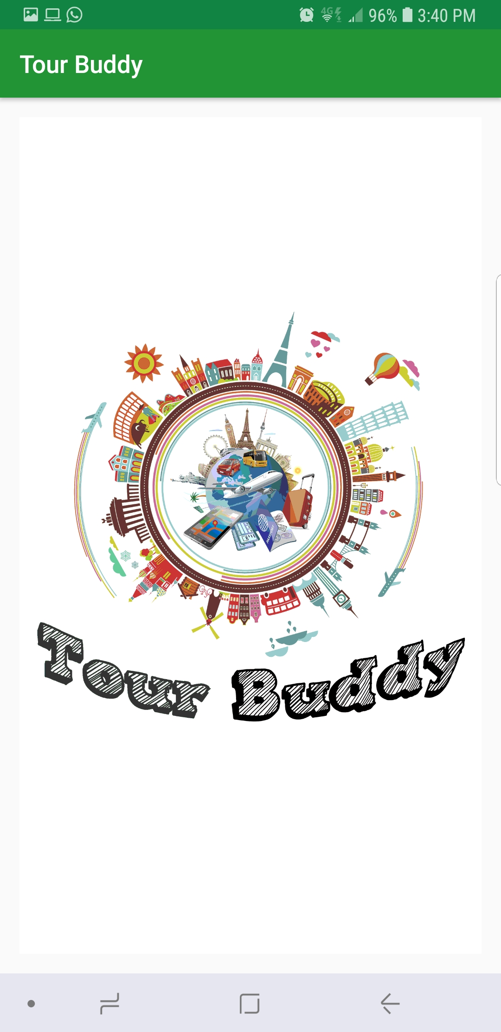
Screen 1- Launcher Screen
This is the launcher screen which includes a gif.

Slide 7
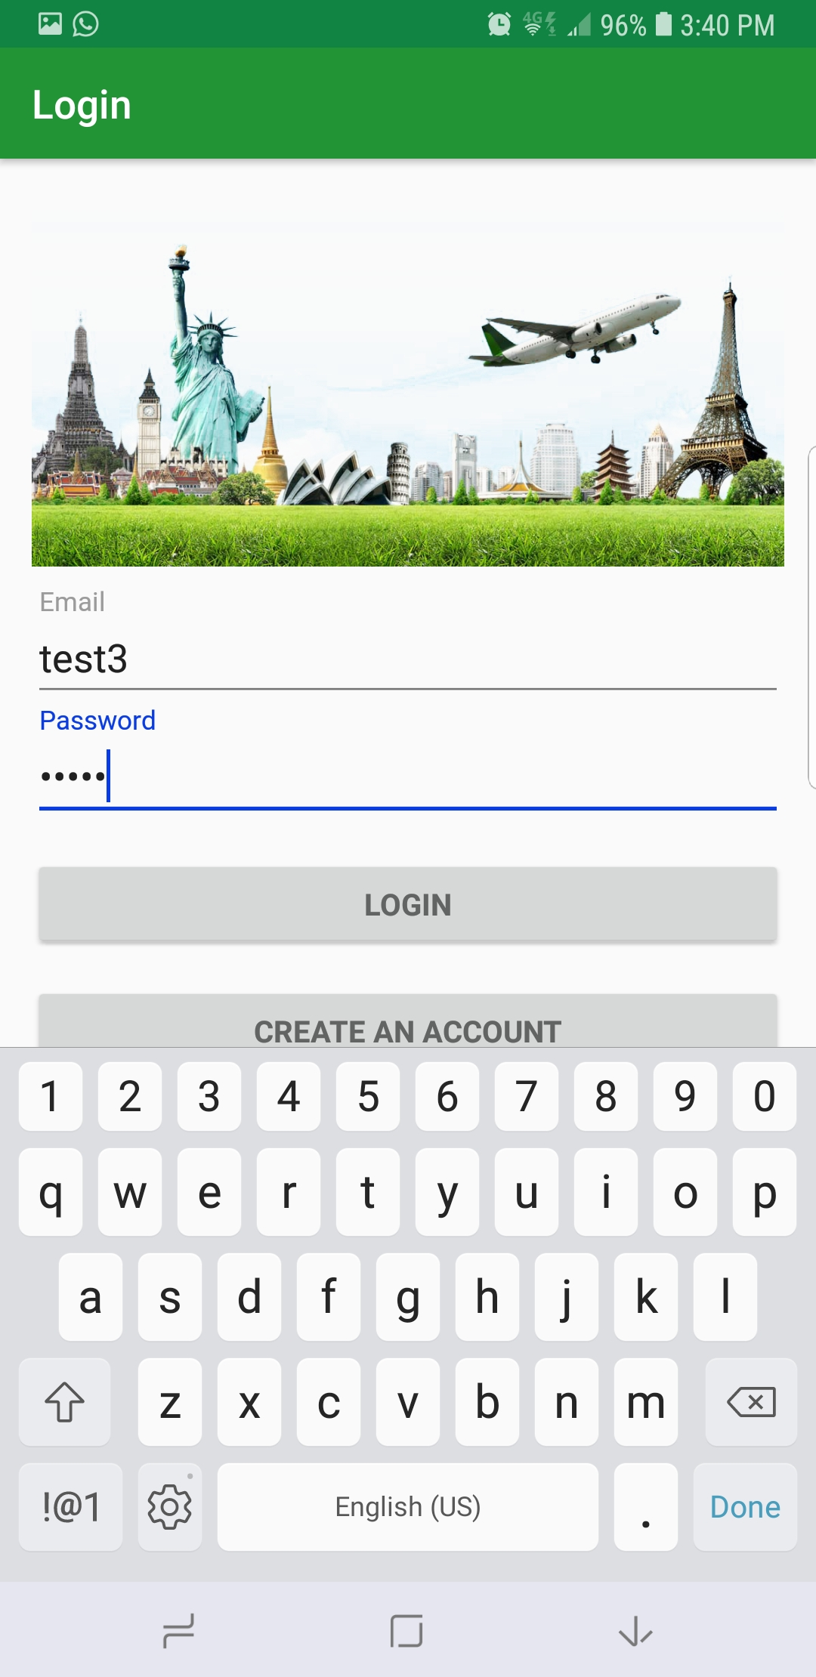
Login Screen
This is a Login screen, where user can login using email/password and can manage his account.

Slide 8
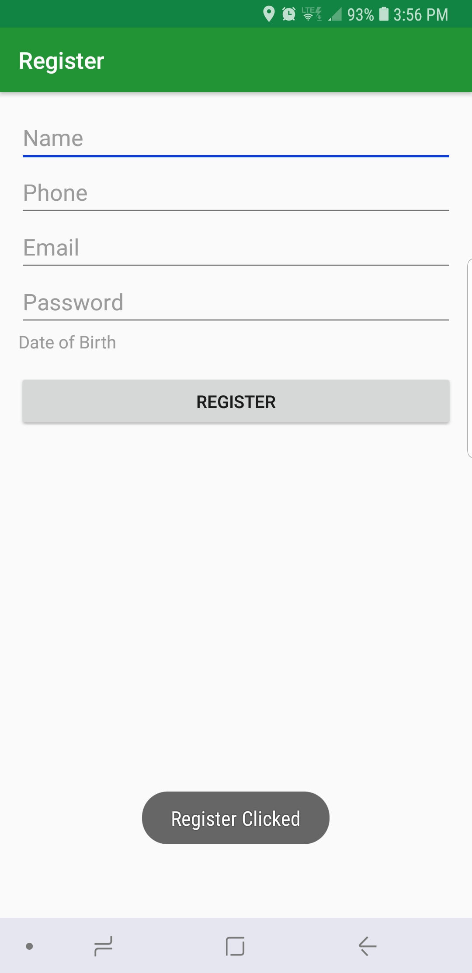
Registration Page
In this screen, a new user can register by entering his details.

Slide 9
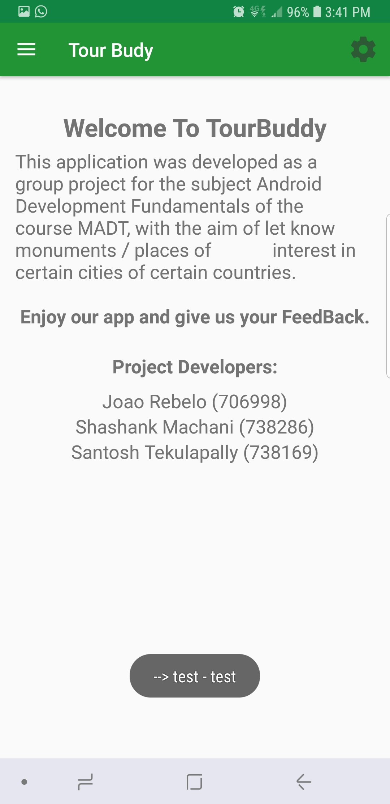
HomeScreen Page
This page contain short description of the application and its developers. And the user can navigate to the different menus from this screen.

Slide 10
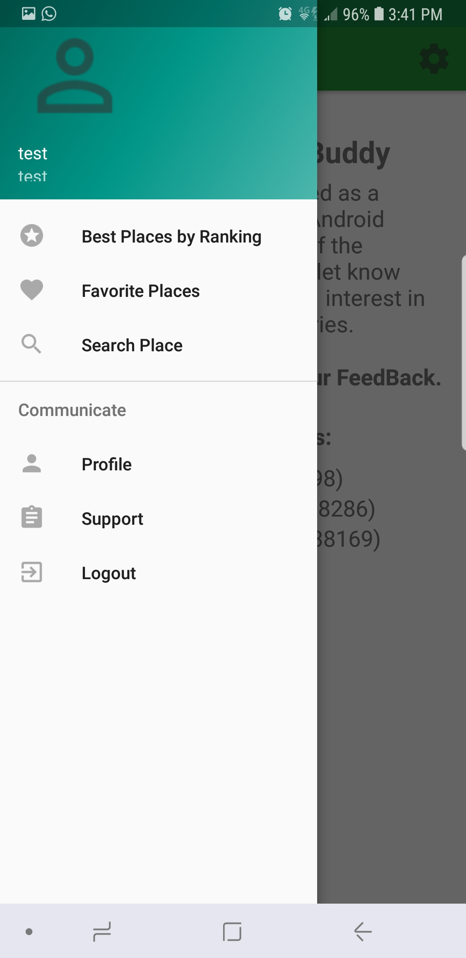
Navigation Drawer
It is used to navigate to different menus.

Slide 11
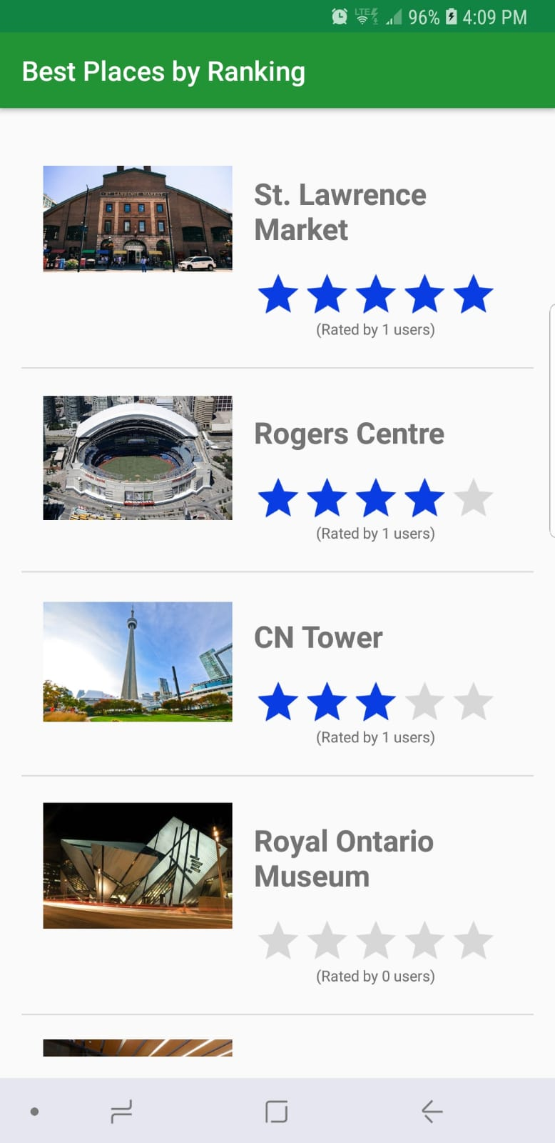
Best Places by Ranking
This screen includes all the places which are ranked by most of the visitors and is arranged according to the number of ratings.

Slide 12
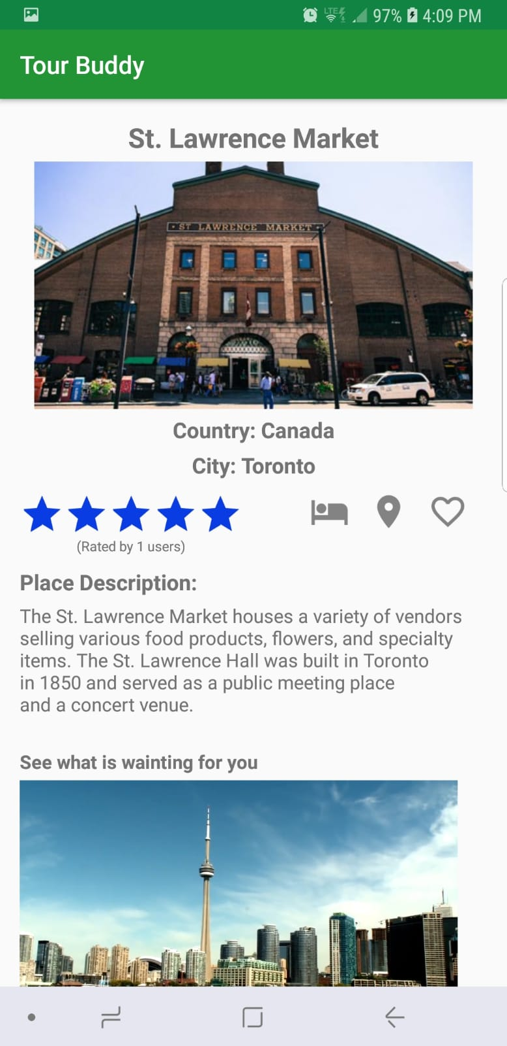
Description of Place
This screen includes descritpion of the place along with picture and a small video. A user can also rate the place and can also make reservation. The user navigate to the place using google maps. The user can also add to his favorites.

Slide 13
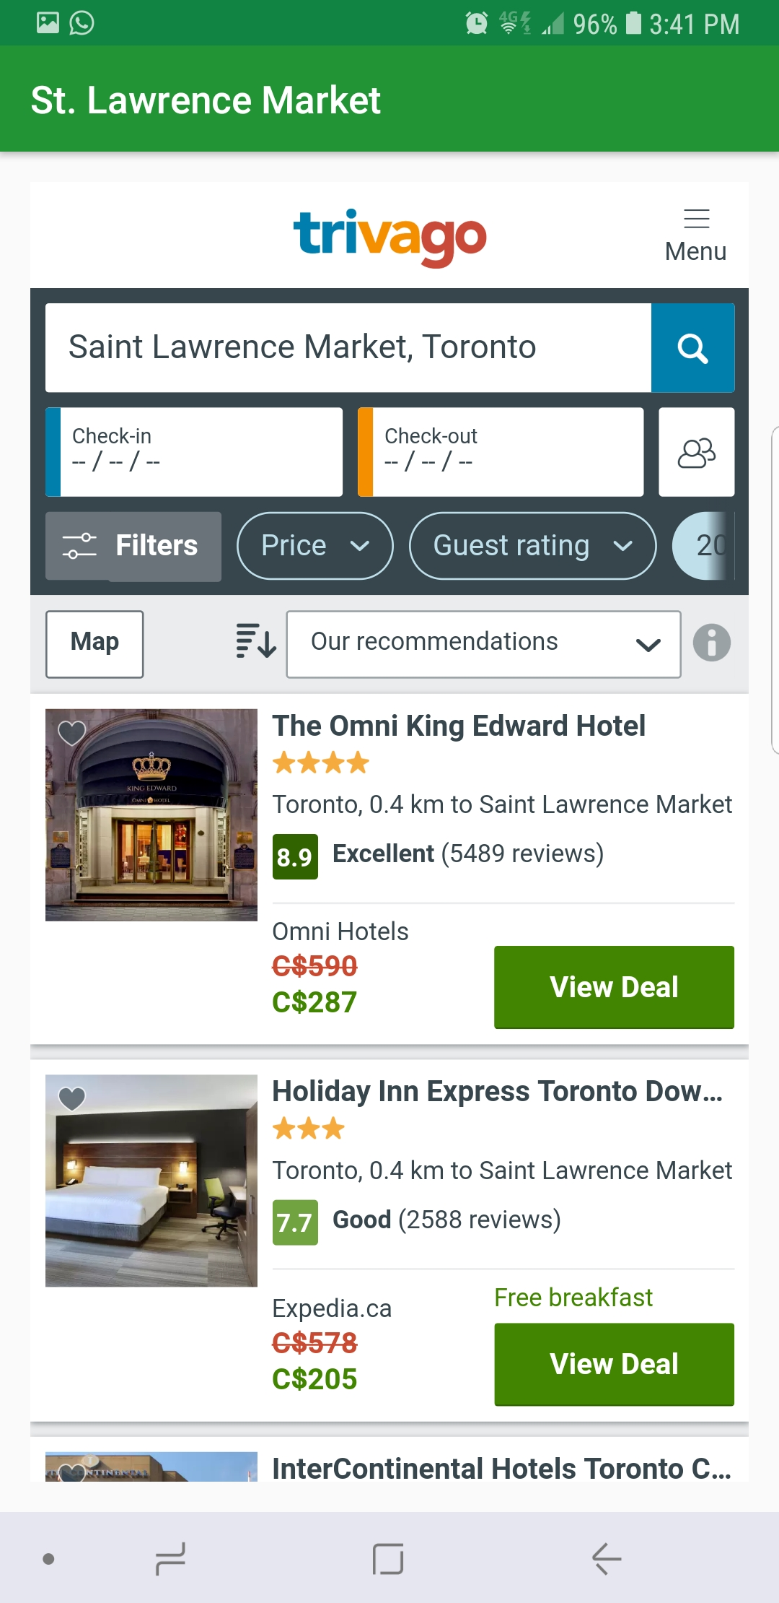
Booking Screen
In this activity, the user can book for stay/travel to that particular place.

Slide 14
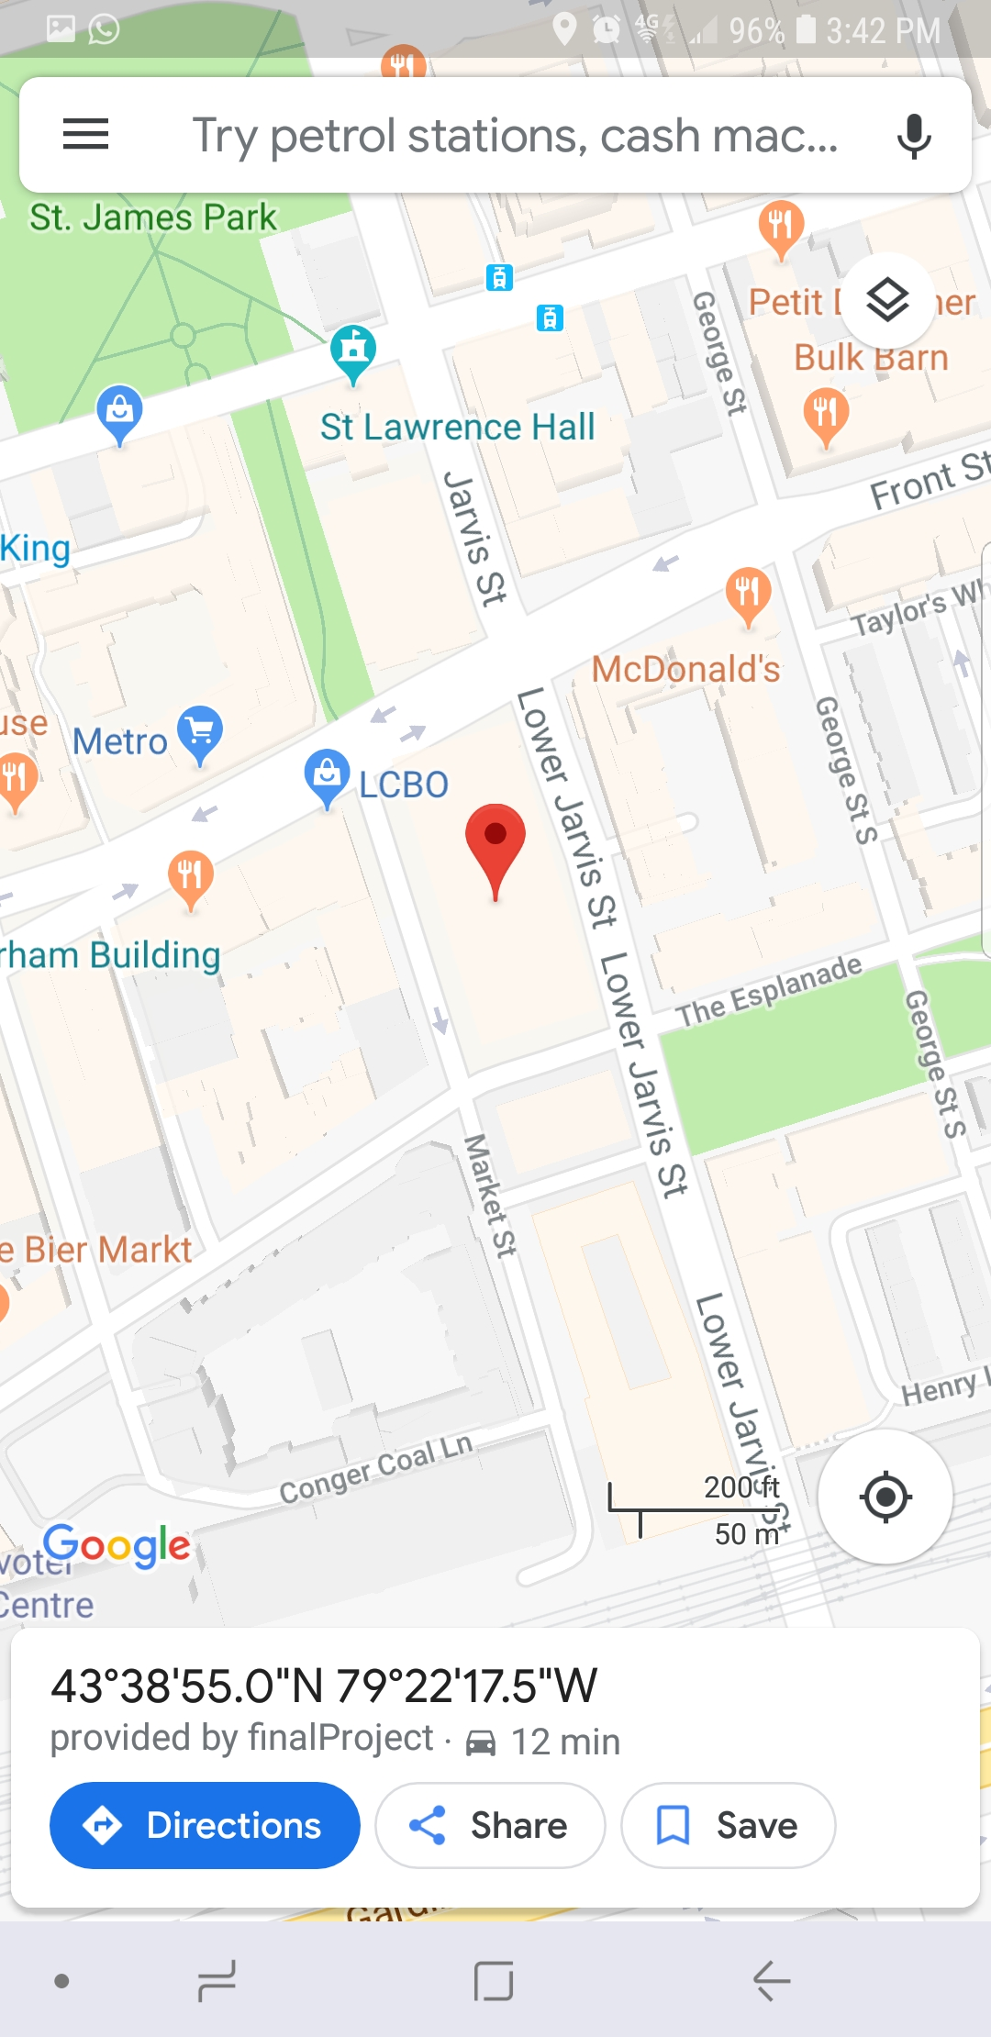
Navigation Screen
The user can navigate to the place using google maps.

Slide 15
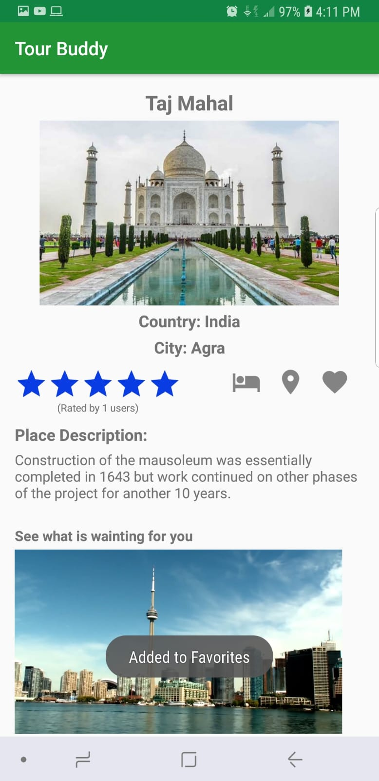
Adding to Favorites
A user can add places to his favorites by long pressing on the heart button in the screen.

Slide 16
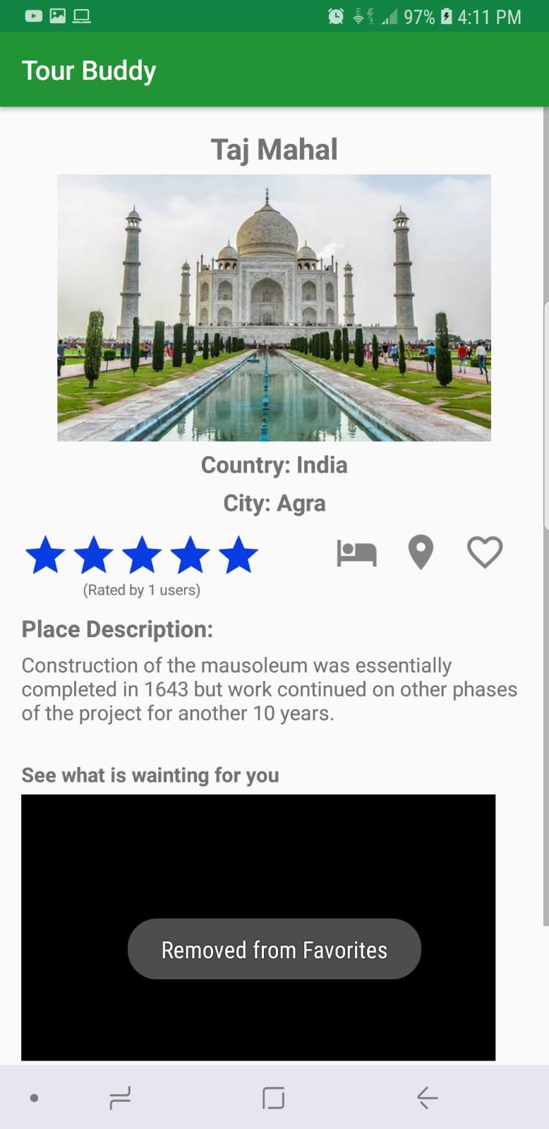
Removing from Favorites
User can remove places from favorites by long pressing on the heart button on the screen.

Slide 17
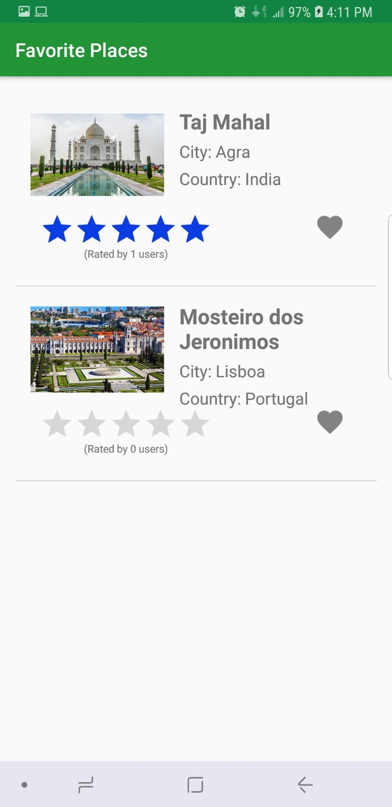
Favorite Places
The user can manage all his favorite places.

Slide 18
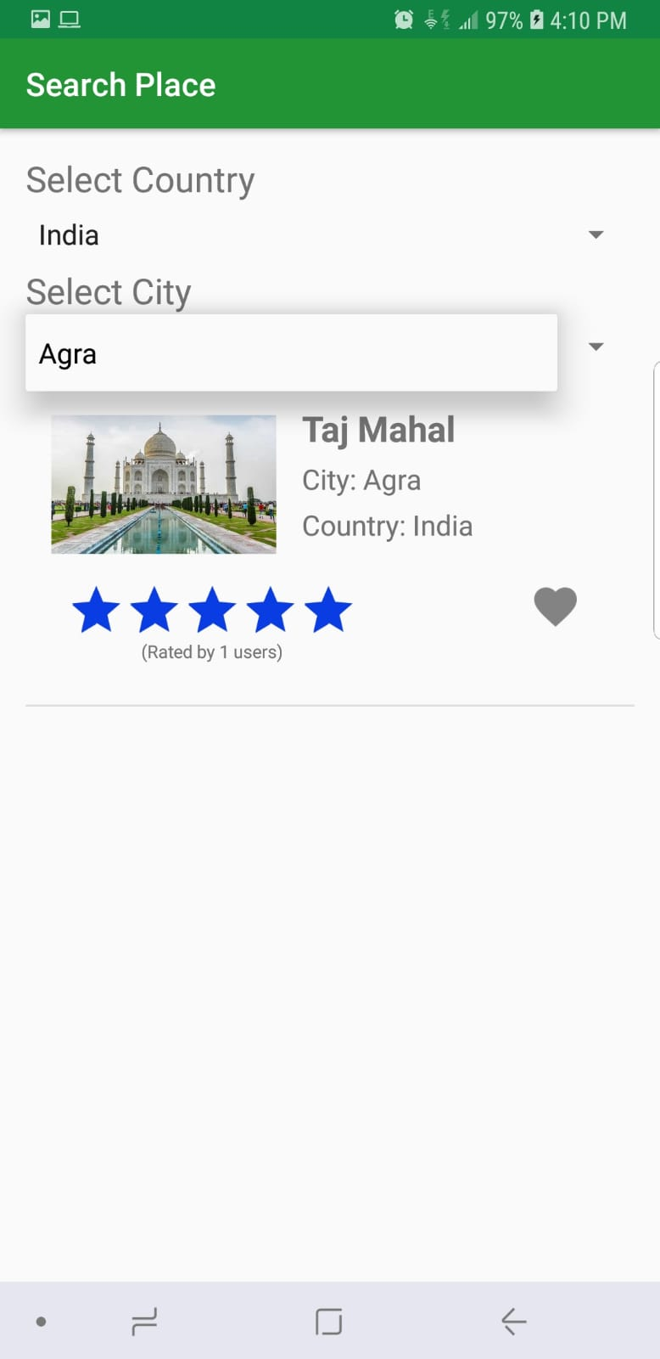
Search Places
In this screen the user can search places by selecting county and the cities.

Slide 19
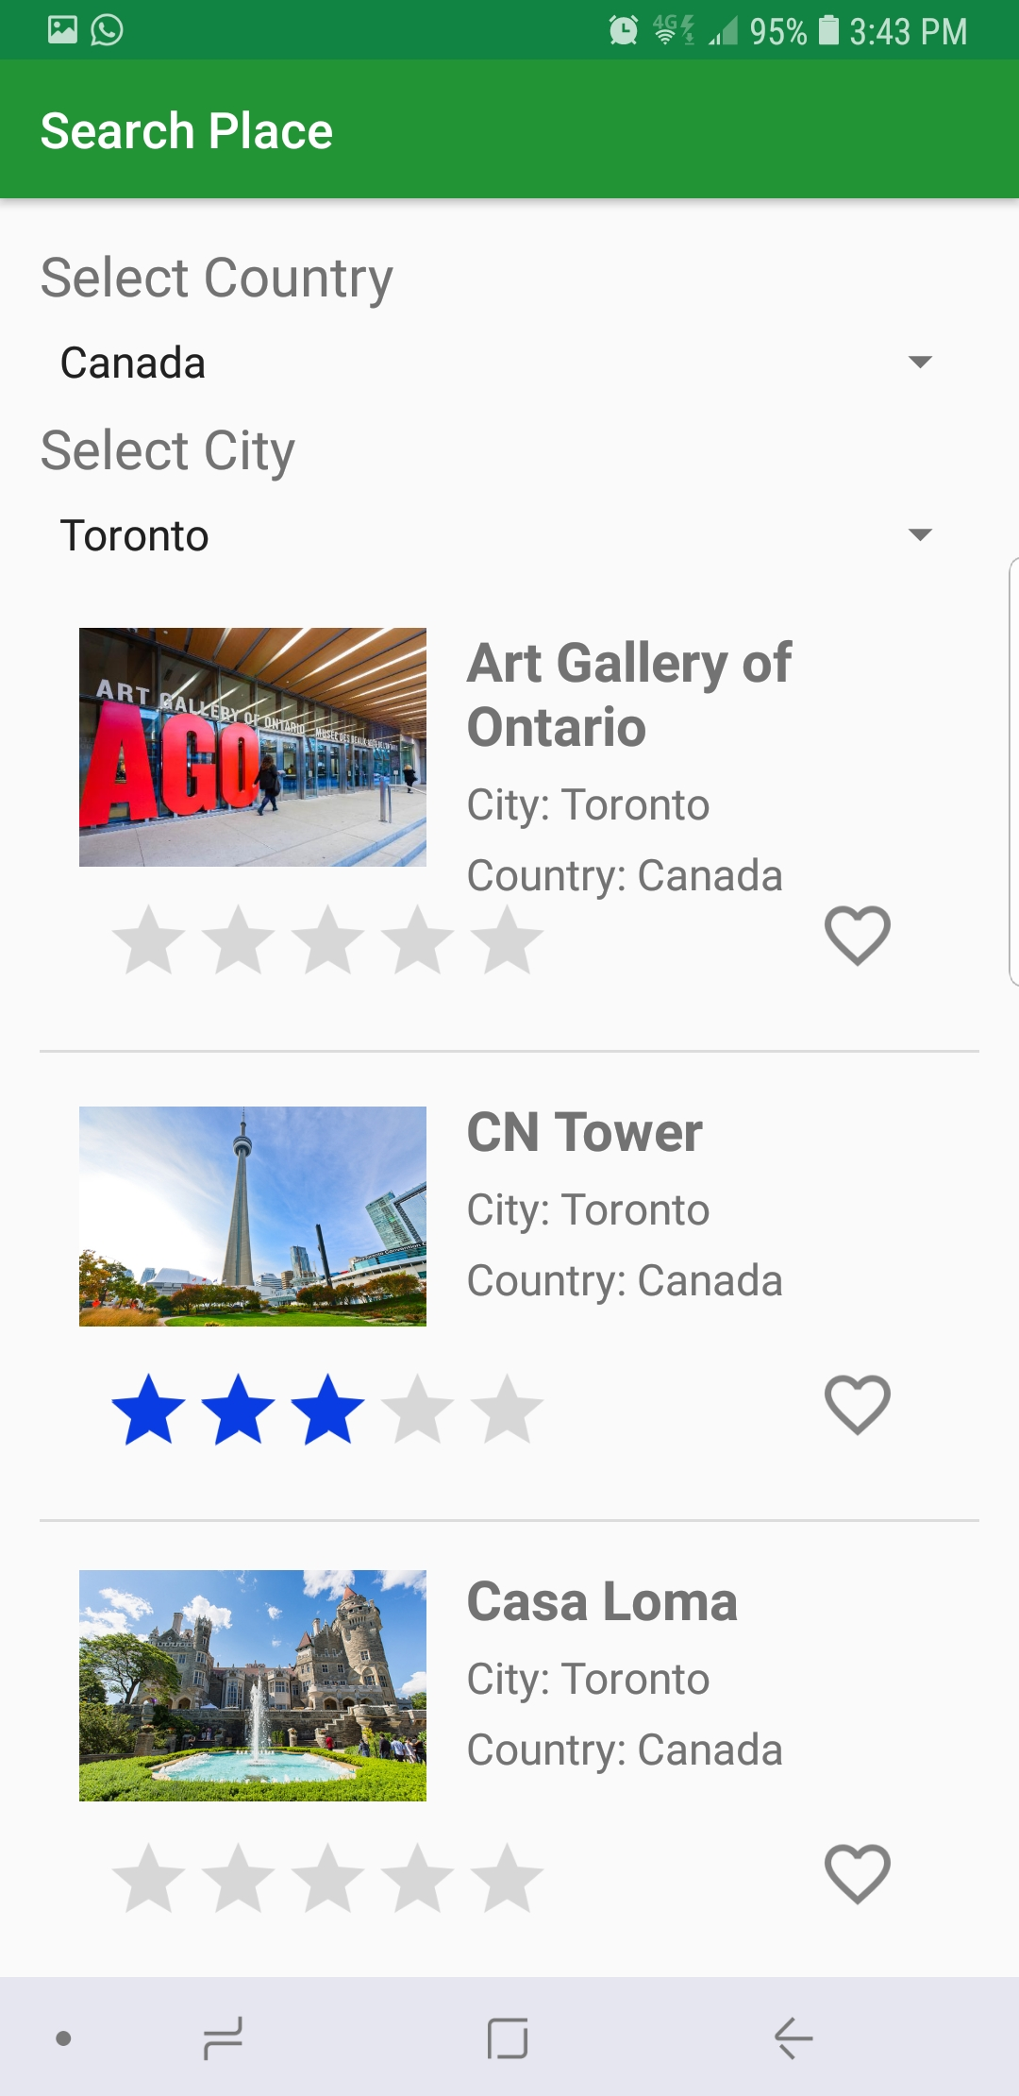
Search Page
Here the user can see all the search results for his selection.

Slide 20
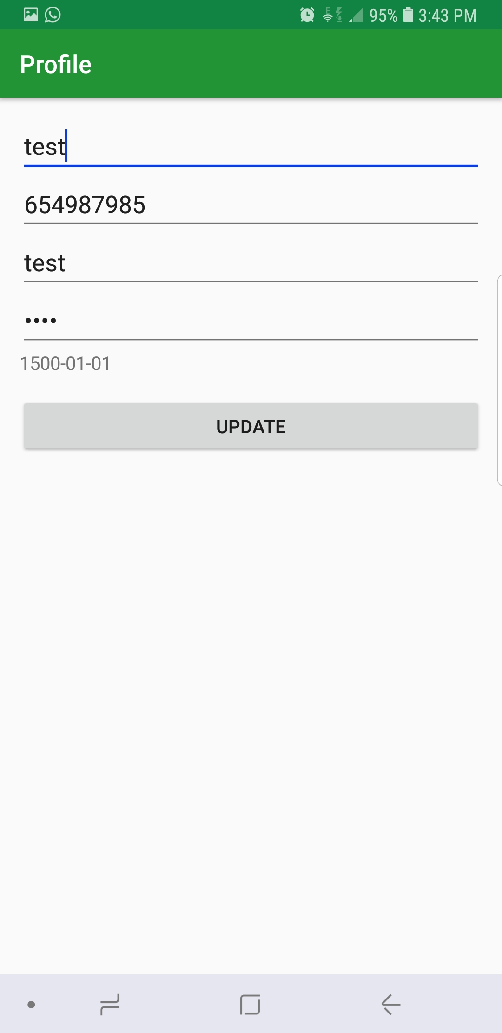
Profile Page
Here the user can update his personal information.

Slide 21
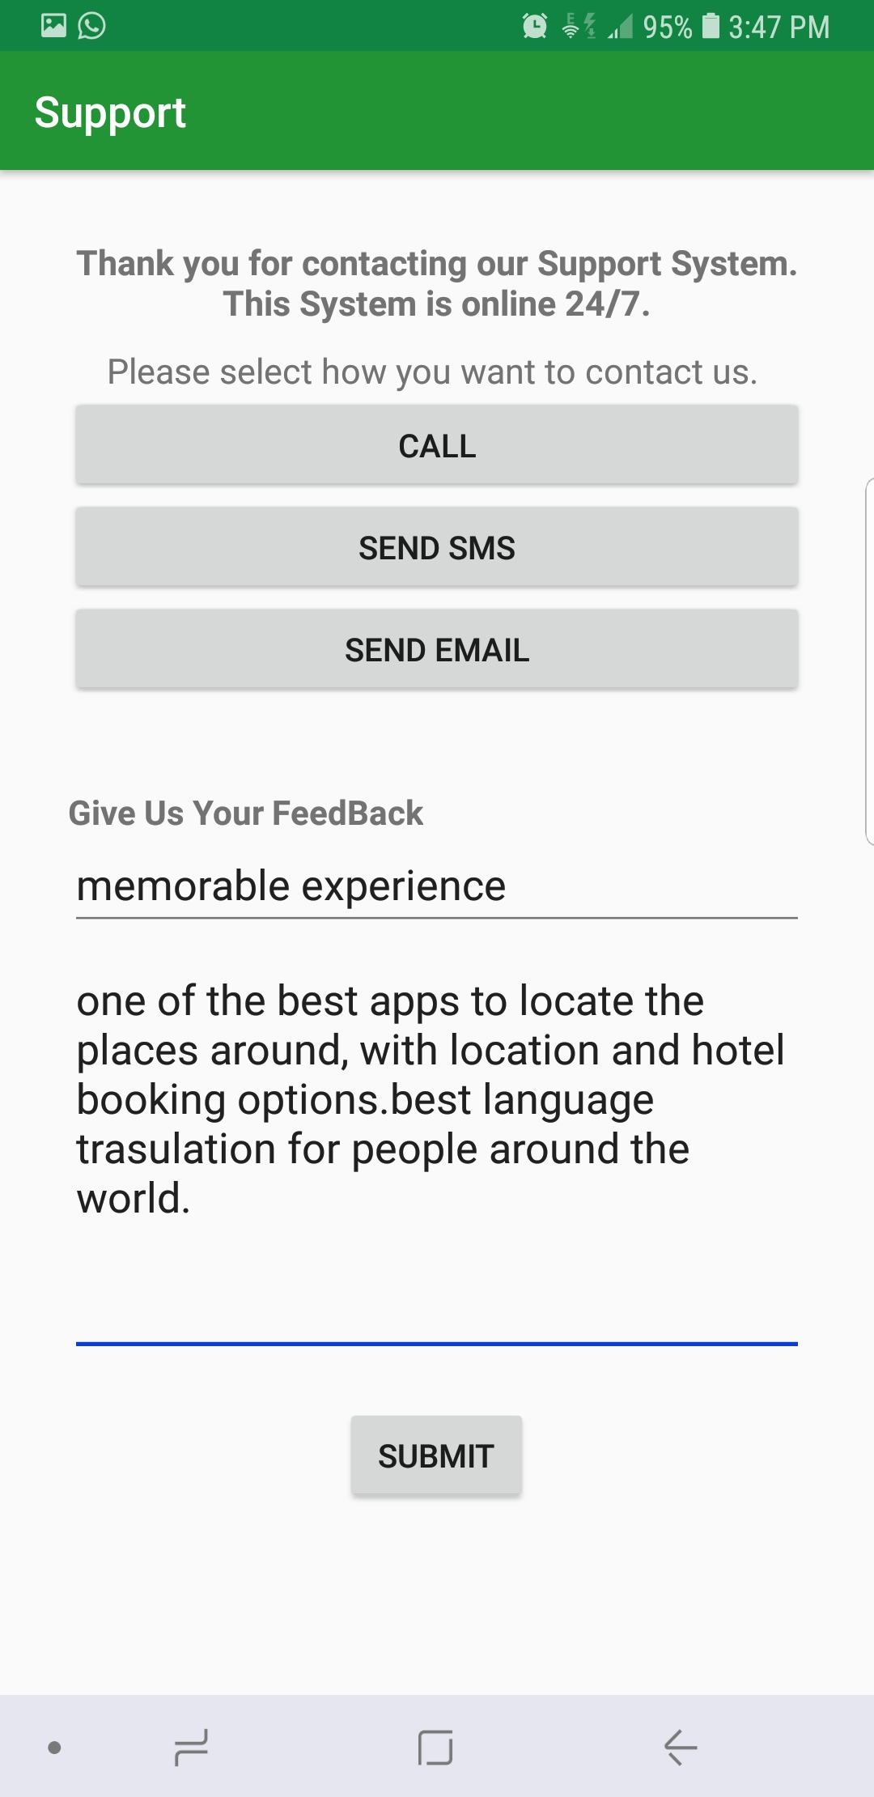
Support Screen
In this page the user can submit his queries and feedback to the support system via,
CALL
SMS
EMAIL

Slide 22
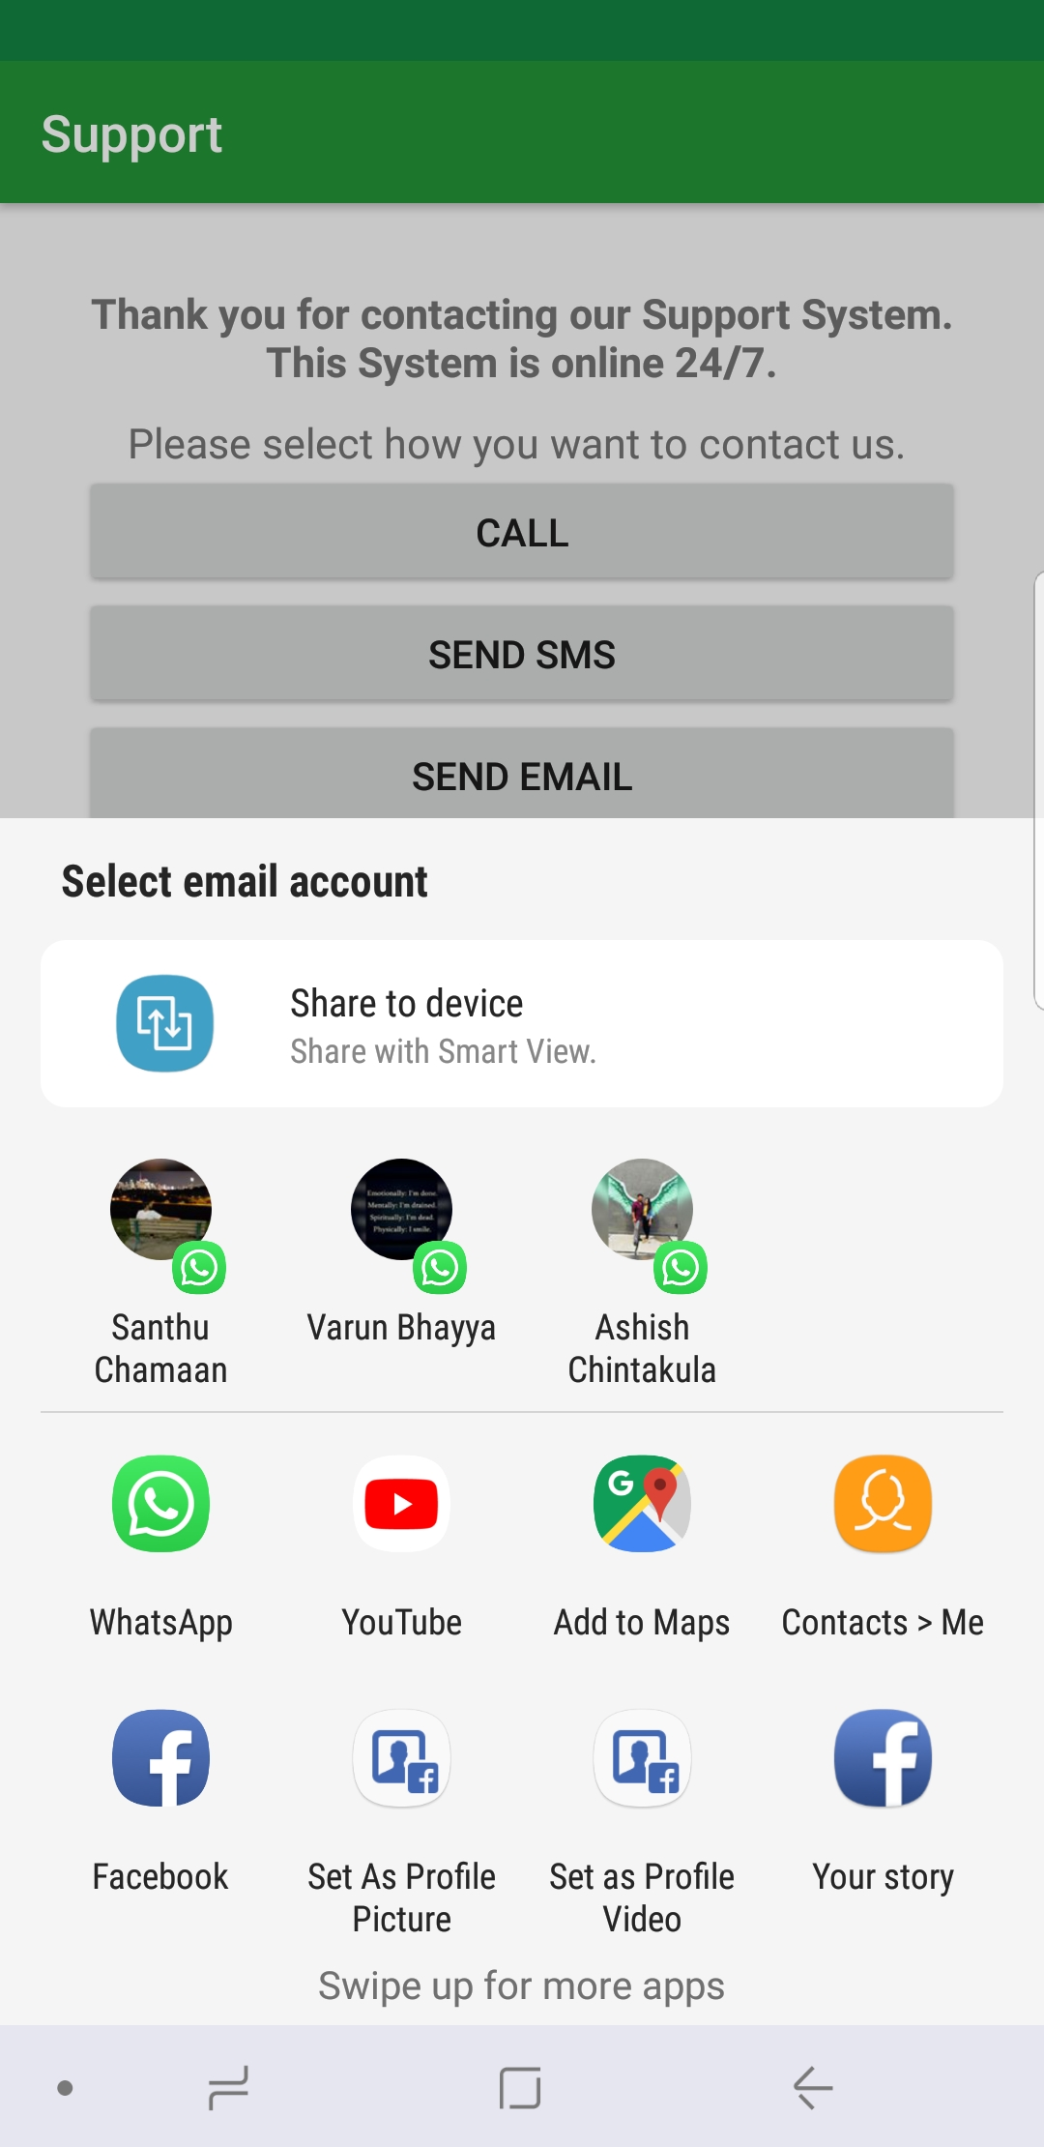
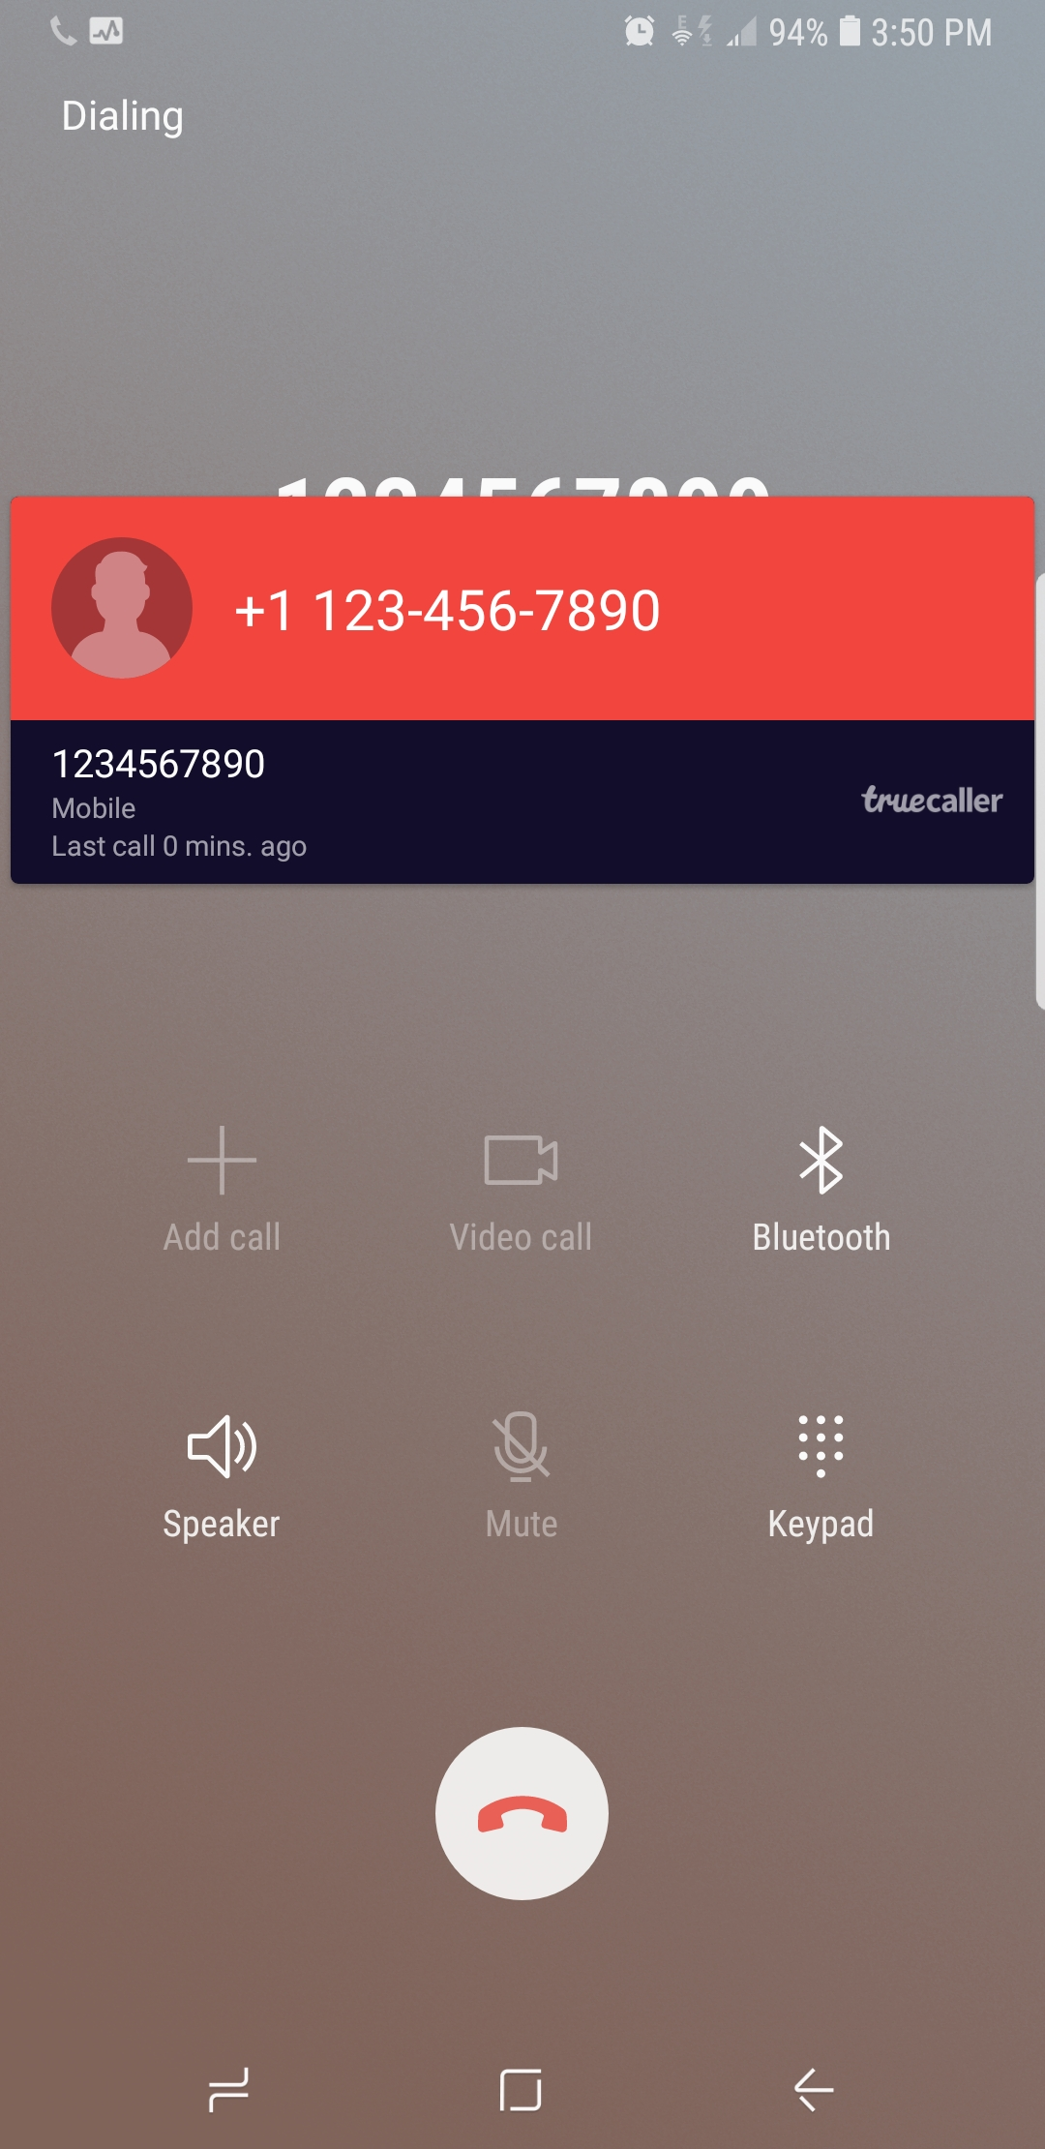
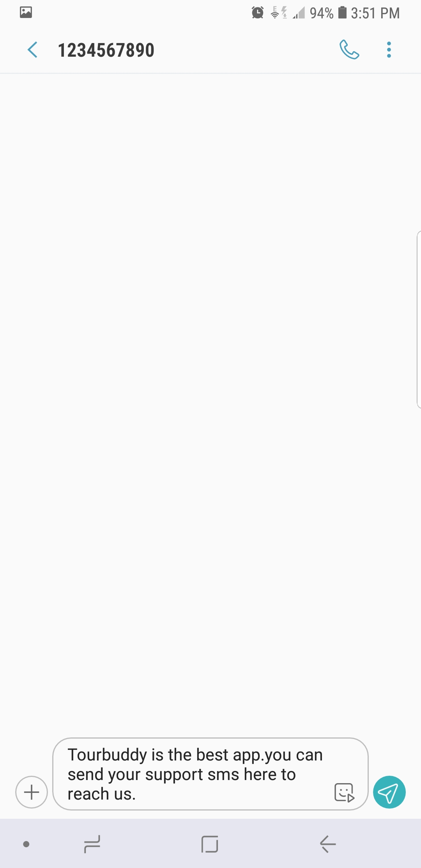
Call, SMS , Email :

Slide 23
Sprint Followed
Sprint 1 | Sprint 2 | Sprint 3 | Sprint 4
25 Jun 2018 Monday | 27 Jun 2018 Wednesday | 03 July 2018 Tuesday | 06 July 2018 Friday
Logo (Name Of Application) Login page Design User Registration Home Screen Design Launcher Screen Navigatio Drawer at Home screen | Connection with database Higher Ranked Places Profile (Show and update) Logout Support Model(Entities) | Search Place (by country, city and place) Show City description and places in that city Favorite System Favorite Page | Place Screen Ranking System Map Web view

Slide 24
Difficulties Faced & Lessons Learnt
Problems faced when update all the pages like the varaiables always up to date, pass place dteails again by pressing back
Problem faced when using the recycler view.
While implementing Double spinners.
Learned – all the things we learned in class like create a webview, adapters.

Slide 25
References
https://www.tutorialspoint.com/android/index.html
https://www.google.ca
Trivago

